Slide 1
Walmart Internship
Midterm Report
Zehao Guan

Slide 2
Timeline
Project Progress
Challenge
Future Work

Slide 3
Timeline
1st week | Orientation; Prepare work; Learn Hadoop/Hive/PySpark; Study pipelines.
2nd week | Practice with onboarding problems; Study papers. https://gecgithub01.walmart.com/Athena/test-experiments/tree/master/Zach
3rd week | Practice recommendation on movielens dataset; Join the shareholder meeting. https://gecgithub01.walmart.com/z0g00mx/Intern_project/tree/master/practice_on_movielens_data
4th week | Query sampled dataset by Hive; Data cleaning, preprocessing & analysis.
5th week | Apply ALS based matrix factorization for collaborative filtering; Write ranking metrics for evaluation.
6th week | Apply BPR model on the same dataset; Improve experimental steps. https://gecgithub01.walmart.com/z0g00mx/Intern_project

Slide 4
Project -- Background
Work on Walmart.com transaction table
Offline recommendation on implicit dataset
Based on customer response
Personalized ranking

Slide 5
Project -- Dataset
Table: ucid.common_transaction_model
Source: walmart.com
Purchase date: “2019-04-22” ~ “2019-05-26”
 | Date | Period | # Transactions | File size
Train (80%) & Validation (20%) | ‘2019-04-22’ ~ ‘2019-05-19’ | 4 weeks | 24024451 | 2.6G
Test | ‘2019-05-20’ ~ ‘2019-05-26’ | 1 week | 5570691 | 604M

Slide 6
Project -- Data Preprocess
Select .cid and .catalog_item_id to get user/item table
Indexing user and item to categorical values
Drop infrequent users/items (threshold) and resellers, shrink table and re-index
Get 0/1 or normalized weight matrix
e.g. Train & Validation data
 | # Transactions | # Users | # Items | Sparsity
Raw data | 24024451 | 8437565 | 2048779 | 0.000139%
Processed | 530343 | 26913 | 37828 | 0.0521%
https://gecgithub01.walmart.com/z0g00mx/Intern_project/blob/master/preprocess.ipynb

Slide 7
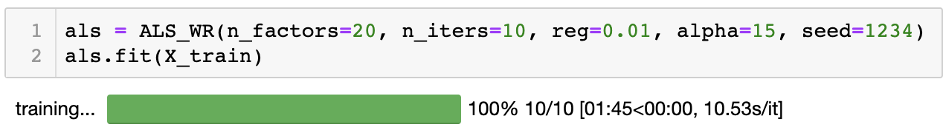
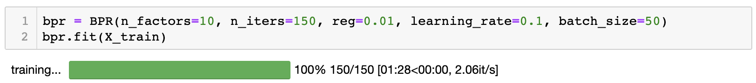
Project -- Baseline Model
ALS based collaborative filtering
https://gecgithub01.walmart.com/z0g00mx/Intern_project/blob/master/als.ipynb
Bayesian personalized ranking (BPR)
https://gecgithub01.walmart.com/z0g00mx/Intern_project/blob/master/bpr.ipynb

Slide 8
Project -- Ranking Metrics
Mean average precision (MAP)
Hit Ratio (HR)
Normalized Discounted Cumulative Gain (NDCG)
Area under ROC (AUC)

Slide 9
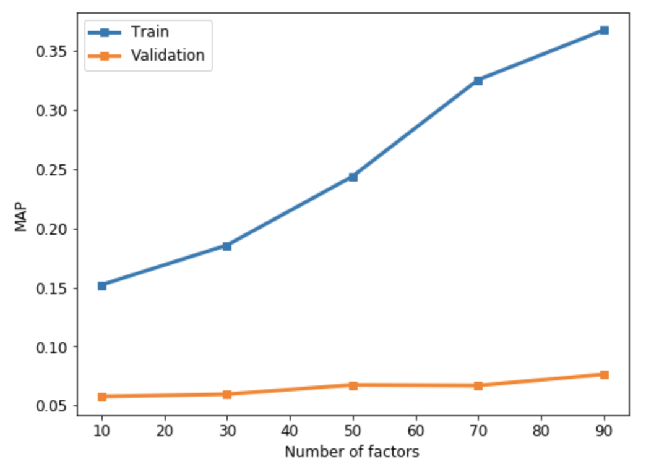
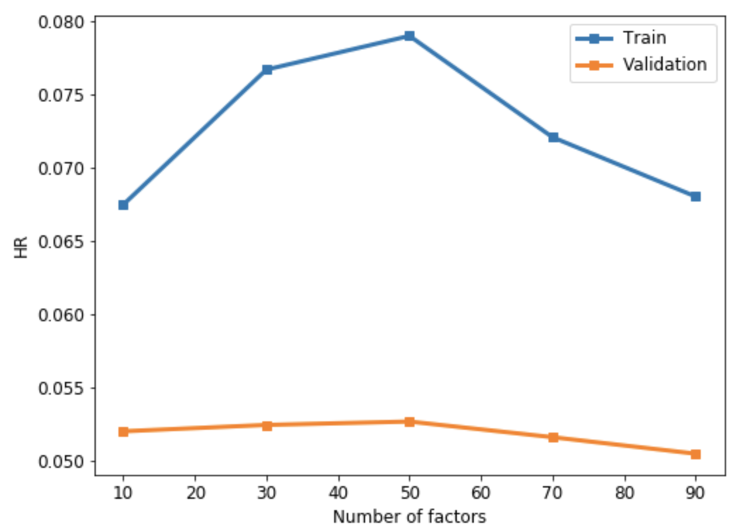
Project -- Result
e.g. Implement first model with different latent dimensionality, ranging from 10 to 100
MAP
HR

Slide 10
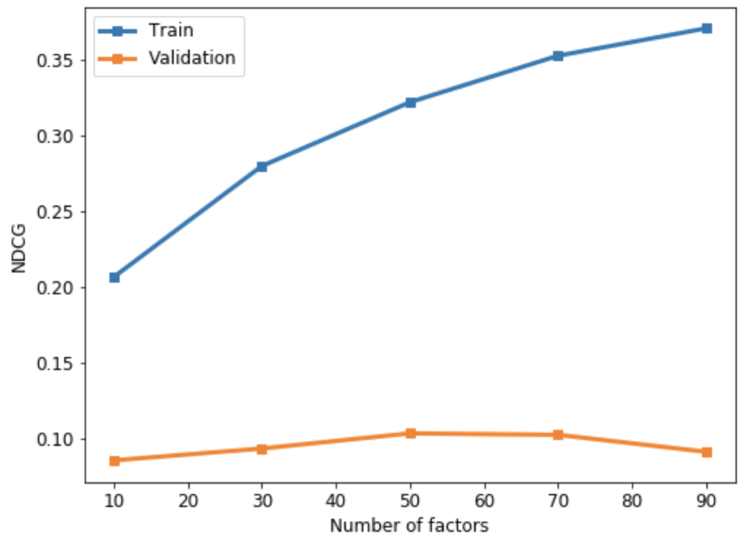
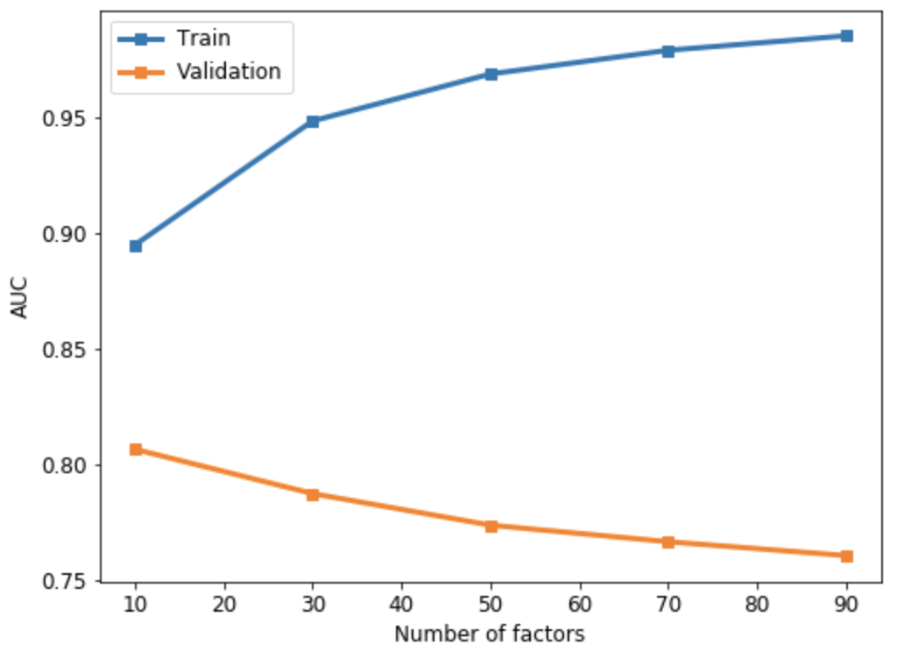
Project -- Result
e.g. Implement first model with different latent dimensionality, ranging from 10 to 100
NDCG
AUC

Slide 11
Challenge
Inexperience with recommendation for implicit dataset
First time to handle such large scale of dataset
Limited 12-weeks length for a research project

Slide 12
Future Work
Complete testing part for two baseline models
Use PySpark to enhance computational efficiency
Test on scalability performance
Improve with more advanced models

Slide 13

Thank You!

